Slide 1

Who could be the Attacker?
Identifying the Terrorist Organization responsible for a Terrorist Attack
by using Machine Learning Technology

Slide 2
Table of Content
Content
Introduction
Methodology
Process Workflow
Results
Conclusions
Future Opportunities

Slide 3






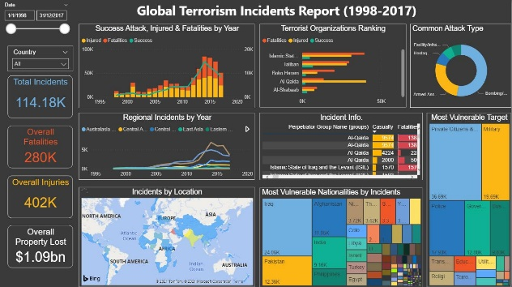
Introduction
About Me
Skills
Portfolio Projects
LI ZHEMING
Global Terrorism Incidents Report (1998-2017)
Data Analysis and Visualization by Power BI
Power Infrastructure Market Analysis in Asia
Interactive Dashboard (Excel & Power Query)
FIFA World Cup Analysis 1930-2014
Create Relational Database & Analyze Data with SQL (SQL & Excel)
Job Title
Data Analyst Trainee
@NTUC LearningHub
Education
Bachelor of Engineering

Slide 4



Introduction
Representing Organization
Target Audience
Consulting firms
Domestic Security Department

Slide 5
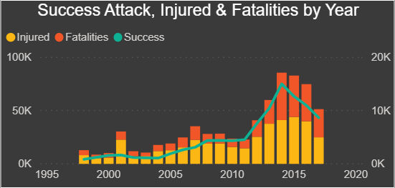
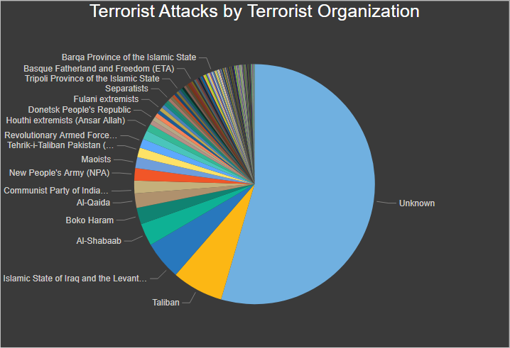
Introduction
Problem Statement
In the recent 20 years, Terrorist Attacks show an actively up-trending growth. It's getting threatening.
Less than 50% of the Attacks are Identifiable for the attackers. We are short of knowledge of these attackers.
If we could identify the Attacker from the features of an on-going Terrorist Attack, we are able to retrieve the Attacker’s behavior pattern from historical records and react to it accordingly.
Furthermore, if we could identify the Attacker of historical unknown attacks, it could facilitate the decision making in preventing future Terrorist Attacks.
Goal=> Build a Machine Learning Model to identify the Attacker of a Terrorist Attack as accurate as possible. => Classification Question
Unknown

Slide 6

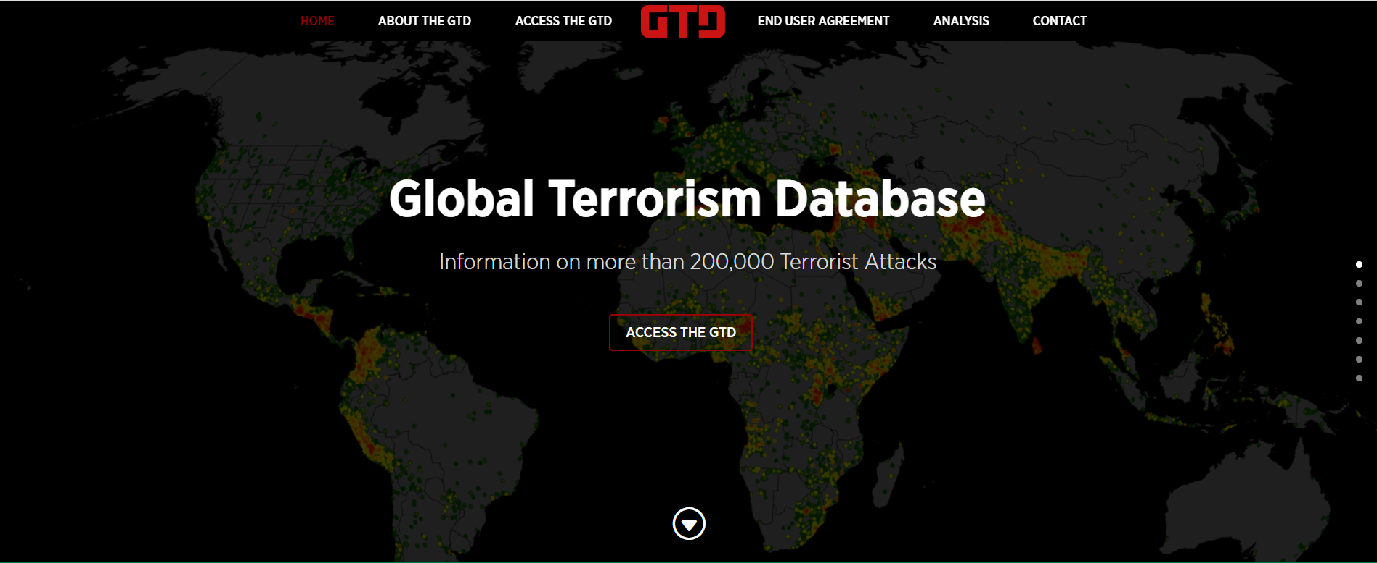
Methodology
Sources:
- Global Terrorism Database : https://start.umd.edu/gtd/
Data Collection

Slide 7
Methodology
Sources:
- Global Terrorism Database : https://start.umd.edu/gtd/
Data Collection
Organization
National Consortium for the Study of Terrorism and Responses to Terrorism (START) at the University of Maryland
Time period
1970-2017, except 1993.
High Information Integrity from 1998 to 2017.
Contents
200,000+ records
135 features
Sources
Unclassified media articles
Codebook
65 pages
Reflecting the systematic collection and coding rules for the Global Terrorism Database
Records: 200,000+
Features: 135
GTD ID & Date
Incident Information
Incident Location
Attack Information
Weapon Information
Target Information
Perpetrator Information
Casualties & Consequences
Additional Information & Sources

Slide 8





Methodology
MODEL
Baseline Model: Logistic Regression
Alternative Model: Support Vector Machine(SVM), Random Forest, Naive Bayes
METRICS
Classification Model
Classification Report(precision,recall,f1-score)
Confusion Matrix
ROC Curve
TOOLS

Slide 9
Process Workflow
Process Workflow
EDA & Data Preparation
Data Analysis & Feature Engineering
Data Transformation
ML Model Training & Evaluation

Slide 10
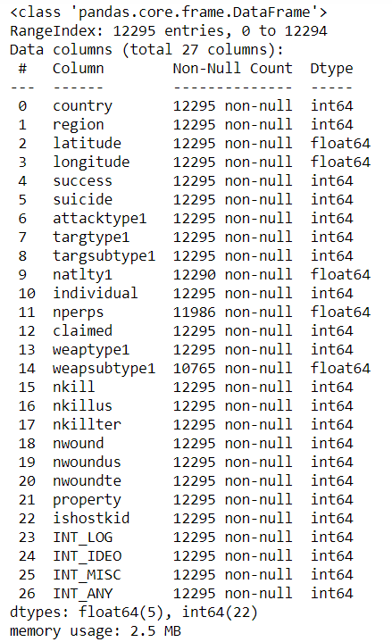
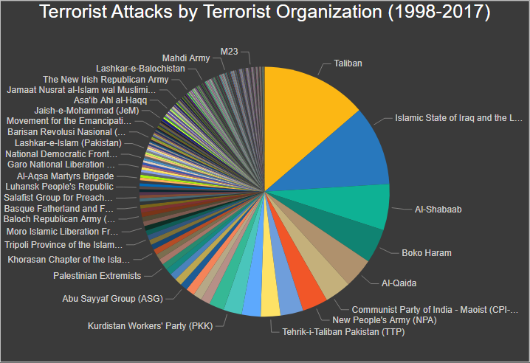
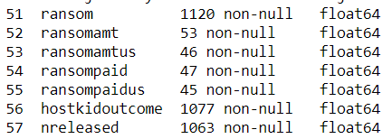
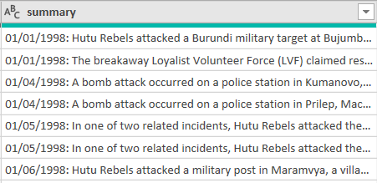
Process Workflow
1. EDA & Data Preparation
Initial Dataset:
Choose High Information Integrity Records
High Information Integrity from 1998-2017.
Pick Top 10 Terrorist Organization
Except for Unknown Attackers, The top 10 Terrorist organizations have committed over 50% of attacks globally.
Subset : Remove records with Unknow Attackers, filter out the records with top 10 attackers
Remove Irrelevant Features
Descriptive text features
Remove Low Information Integrity Features
Features
135
Records
200,000+
Records
114,000+
Records
14,000+
Features
62
Features
27
Records
12,000+
ML Dataset

Slide 11
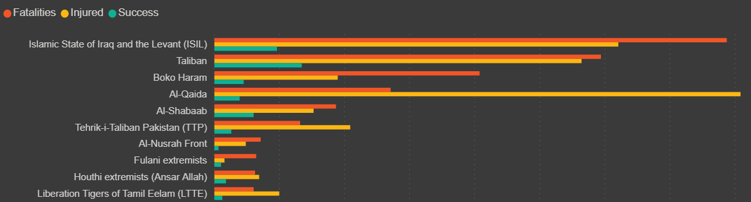


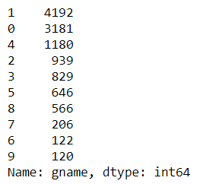
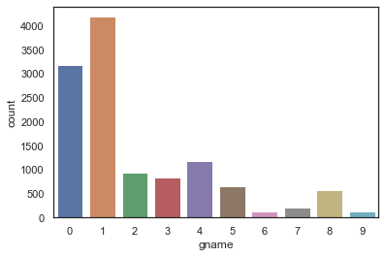
Process Workflow
1. EDA & Data Preparation
Map Text Labels into Numerical Numbers
gname: Name of Terrorist Organization
Explore Label Distribution
This is an imbalanced dataset

Slide 12
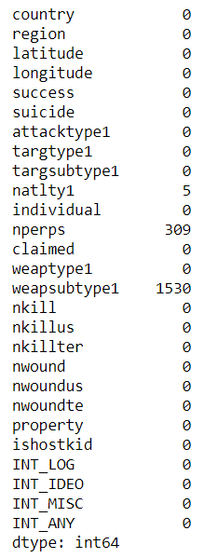
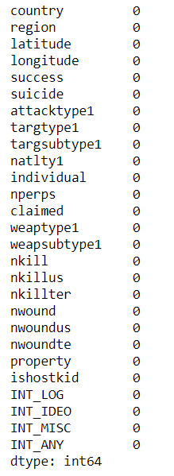
Process Workflow
1. EDA & Data Preparation
Drop/Fill up N.A.
Number of N.A. in each features

Slide 13
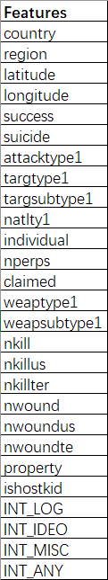
Process Workflow
2. Data Analysis & Feature Engineering
Four Questions towards Features
Does this feature represent the characteristics of the Terrorist Organizations?
Good features will show different behavior pattern among Terrorist Organizations
Is this feature measurable in the early stage?
If it is measurable, it could help us to identify the attacker of an on-going attack in the early stage.
Is this feature highly correlated with other features? (multicollinearity)
Only one feature from the highly correlated features group will be selected to avoid bias.
Is this a nominal categorical feature?
One-Hot Encoding on a nominal feature with huge values will create tremendous new features and cost extra-ordinary processing resources

Slide 14
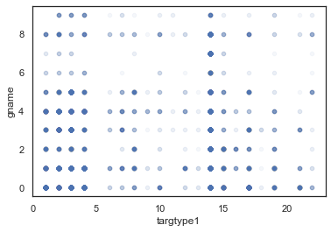
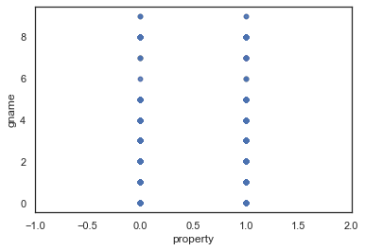
Process Workflow
2. Data Analysis & Feature Engineering
Does this feature represent the characteristics of the Terrorist Organizations?
Good features will show different behavior pattern among Terrorist Organizations
Example:
Good Feature: Target/Victim (nominal)
Bad Feature: Is Property Damage? (binary)

Slide 15
Process Workflow
2. Data Analysis & Feature Engineering
Is this feature measurable in the early stage?
If it is measurable, it could help us to identify the attacker of an on-going attack in the early stage.
Relies on Domain Knowledge.
Example:
nperps (Number of Attackers)
We might not be able to know the number of attackers of an on-going attack.
INT_IDEO (International- Ideological)
We are not able to know whether the nationalities between attackers and targets are different or not before we identify the attacker

Slide 16
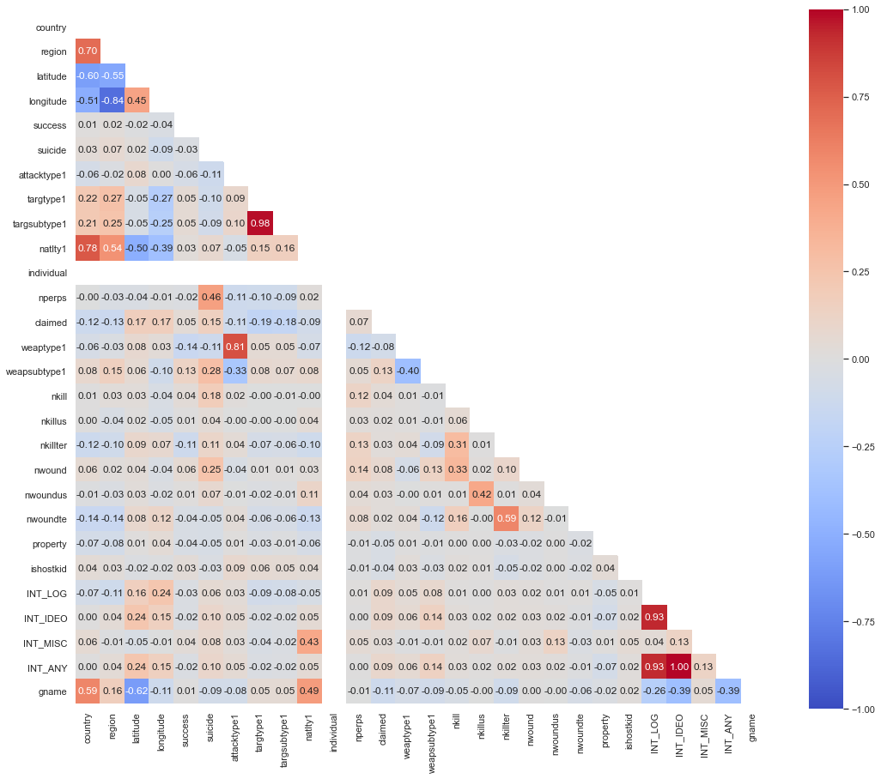
Process Workflow
2. Data Analysis & Feature Engineering
Is this feature highly correlated with other features? (multicollinearity)
Only one feature from the highly correlated features group will be selected to avoid bias.

Slide 17
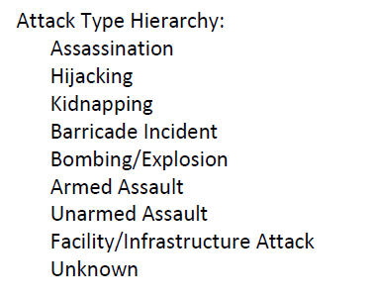
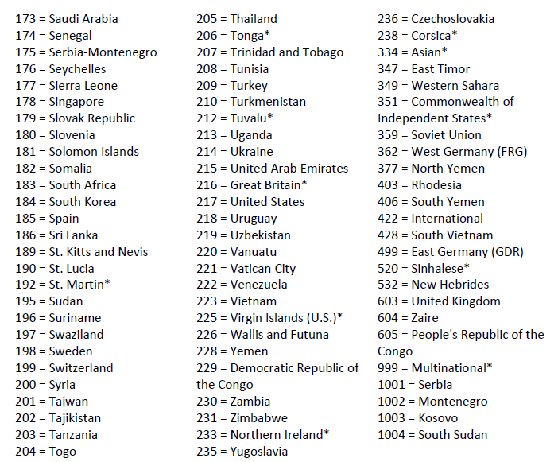
Process Workflow
2. Data Analysis & Feature Engineering
Is this a nominal categorical feature?
One-Hot Encoding on a nominal feature with huge values will create tremendous new features and cost extra-ordinary processing resources
Example:
Good Feature: Attack Type (nominal)
Bad Feature: Country (nominal)

Slide 18
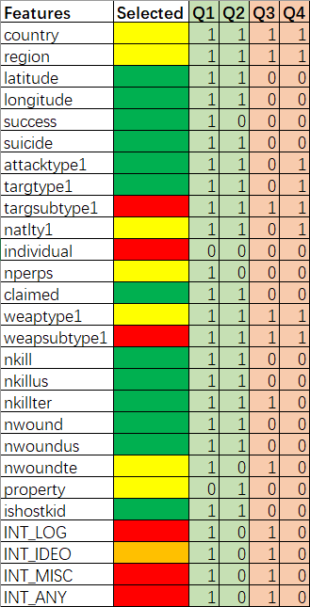
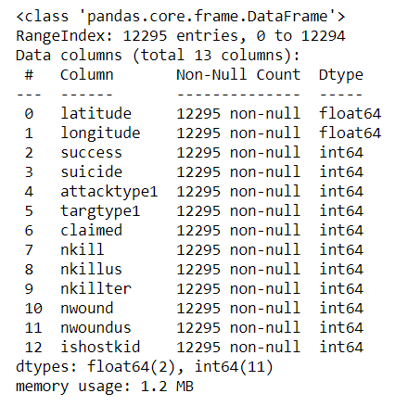
Process Workflow
2. Data Analysis & Feature Engineering
Green: This feature will be selected;
Yellow: This feature will be on hold;
Red: This feature will be dropped;
Orange: This is a special feature (explain latter)
Features
27
Features
13
Records
12,000+
Revised
ML Dataset

Slide 19
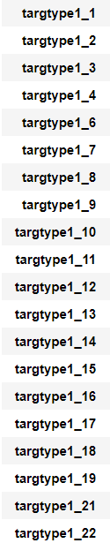
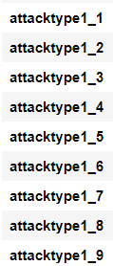
Process Workflow
3. Data Transformation
Features
13
One-Hot Encoding for Nominal Features
Features: attacktype1, targtype1
Split the data into training and testing datasets
test_size = 0.2
Data Normalization
Standard Scaler :
Logistic Regression, Support Vector Machine(SVM), Decision Tree & Random Forest
Min Max Scaler:
Naive Bayes
Features
40

Slide 20
Process Workflow
4. Machine Learning Model Training & Evaluation
MODEL
Baseline Model: Logistic Regression
Alternative Model: Support Vector Machine(SVM), Random Forest, Naive Bayes

Slide 21
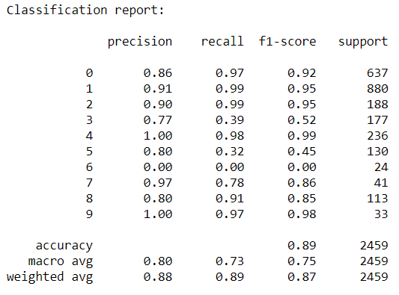
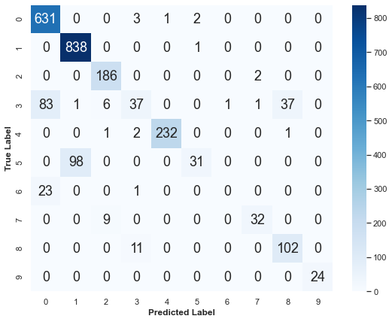
Process Workflow
4. Machine Learning Model Training & Evaluation
Baseline Model: Logistic Regression
Baseline Model: Logistic Regression
Hyperparameter: (max_iter=5000)
Classification Report
Confusion Matrix

Slide 22
Process Workflow
4. Machine Learning Model Training & Evaluation
Baseline Model: Logistic Regression
Observation
Poor performance in classifying Class 3,5
Extreme poor performance in classifying Class 6
Class 6 tends to be predicted as Class 0
=> Some of the labels with relatively fewer samples are showing poor performance, so macro f1-score will be appropriate for this dataset to offset the bias caused by the majority correctly predicted labels.
Classification Report
Solution
Introduce more features
Alternative Model
Confusion Matrix

Slide 23
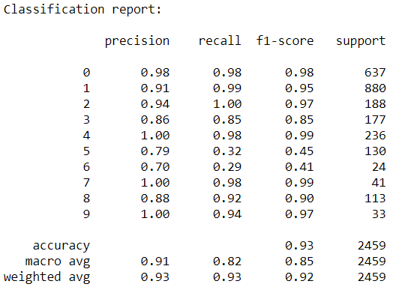
Process Workflow
Introduce more features
Baseline Model: Logistic Regression
Best extra feature: INT_IDEO (the Orange special feature)
Classification Report (with INT_IDEO)
Classification Report (Original Model)

Slide 24
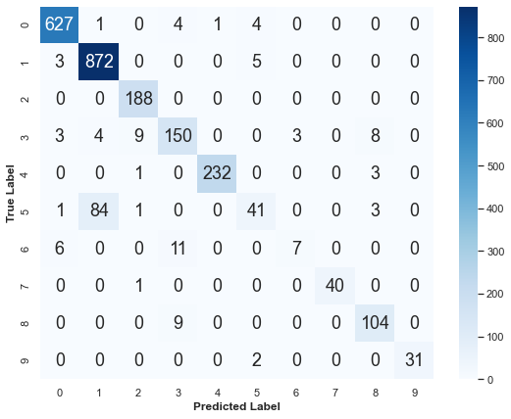
Process Workflow
Introduce more features
Baseline Model: Logistic Regression
Best extra feature: INT_IDEO (the Orange special feature)
Confusion Matrix (with INT_IDEO)
Confusion Matrix (Original Model)

Slide 25
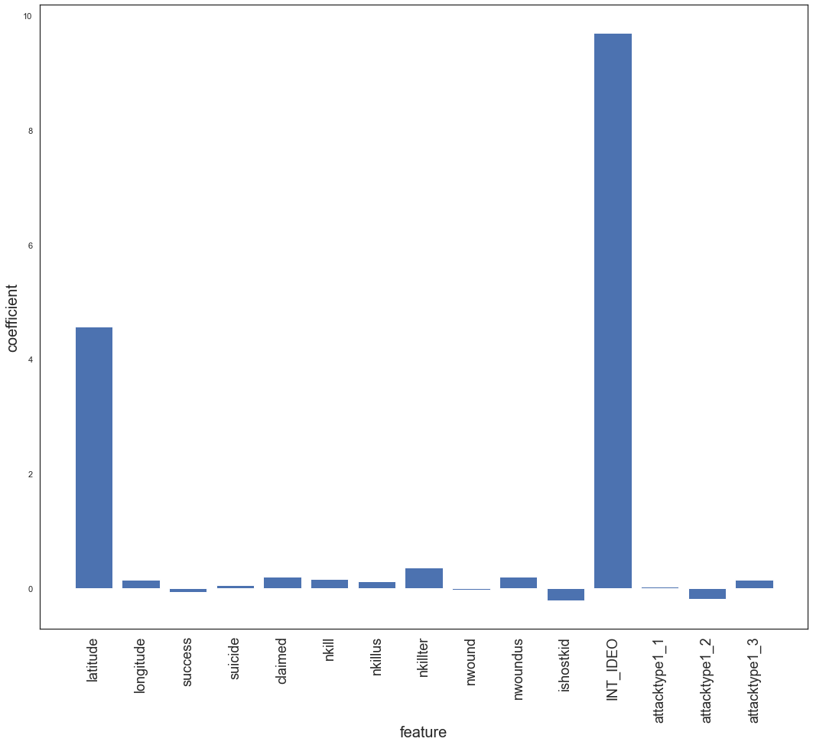
Process Workflow
Introduce more features
Baseline Model: Logistic Regression
Best extra feature: INT_IDEO (the Orange special feature)
Observation
INT_IDEO plays a strong role in classifying Attackers, especially differentiate Class 6 from Class 0
Unfortunately, we couldn’t identify this feature’s value before we identify the Attackers
Solution
Introduce more features
Alternative Model
Features Coefficient bar chart

Slide 26
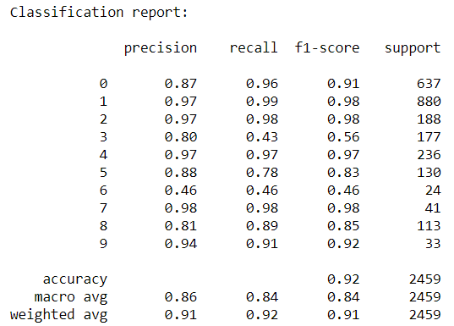
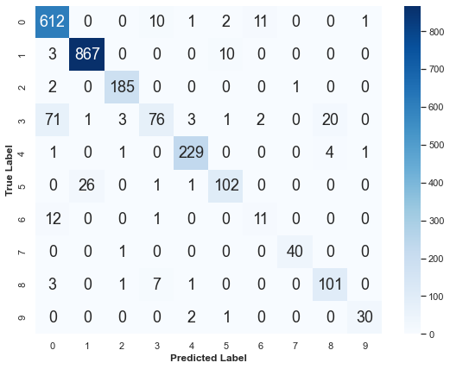
Process Workflow
4. Machine Learning Model Training & Evaluation
Alternative Model: Support Vector Machine
Alternative Model: Support Vector Machine(SVM)
Best Hyperparameter: (kernel = 'rbf’, C = 90, gamma = 0.1668)
Classification Report
Confusion Matrix

Slide 27
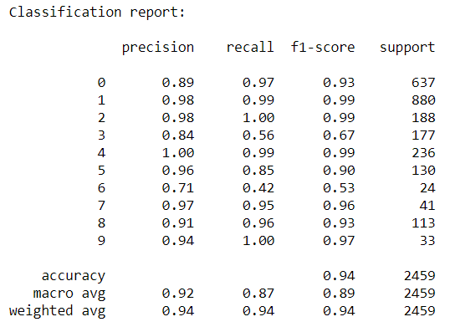
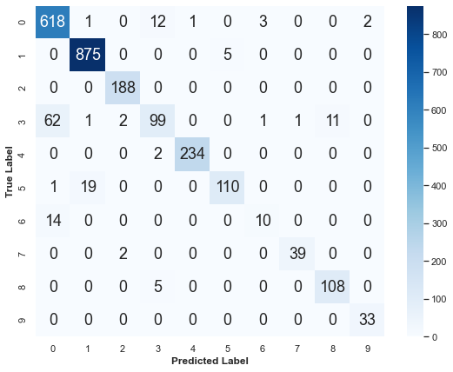
Process Workflow
4. Machine Learning Model Training & Evaluation
Alternative Model: Random Forest
Alternative Model: Random Forest
Best Hyperparameter: (criterion = 'gini', max_depth= 27, min_samples_split=5, n_estimators=500)
Classification Report
Confusion Matrix

Slide 28
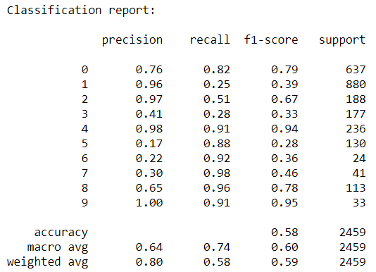
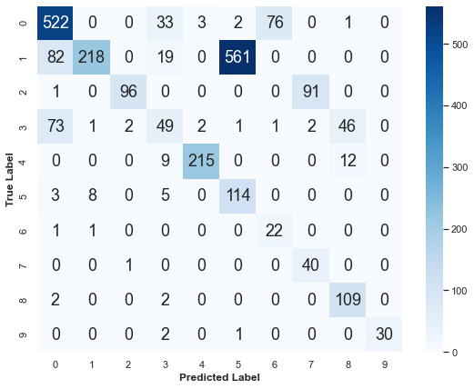
Process Workflow
4. Machine Learning Model Training & Evaluation
Alternative Model: Naive Bayes
Alternative Model: Naive Bayes
Best Hyperparameter: GaussianNB (var_smoothing = 1.2328467394420658e-05)
Classification Report
Confusion Matrix

Slide 29
Results
Results
F1-Score
ROC Curve
Class 6

Slide 30
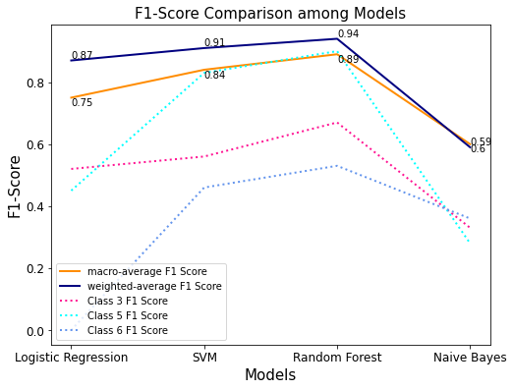
Results
1. F1-Score

Slide 31
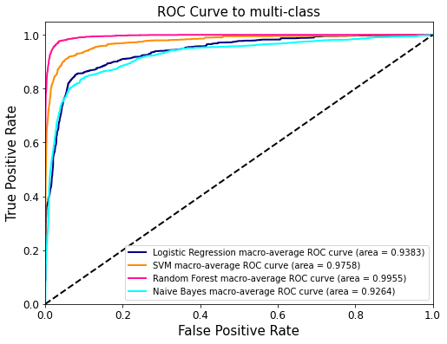
Results
2. ROC Curve

Slide 32
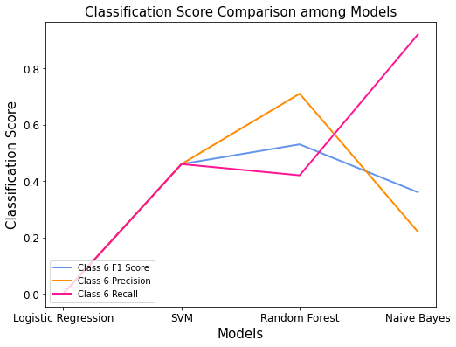
Results
3. Class 6

Slide 33
Conclusions
Conclusions
Random Forest is the best Model to perform this task:
Accuracy : 94%
Macro Average Precision: 92%
Macro Average Recall: 87%
Macro Average F1-Score: 89%
ROC-AUC-Score:0.9955
High performance in Identifying Attackers in both precision and recall rate, which enable Relevant Department to take immediate reaction against an on-going terrorist attack accordingly.

Slide 34
Conclusions
Interesting insights
Why Class 6 always trend to be classified as Class 0 in all Models?
Logistic Regression
SVM
Random Forest

Slide 35
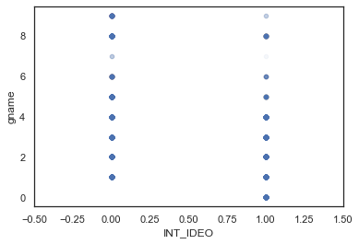


Conclusions
Interesting insights
Why Class 6 always trend to be classified as Class 0 in all Models?
Class 6 : Al-Nusrah Front
Tend to attack both Domestic and International targets.
Class 0: Islamic State of Iraq and the Levant (ISIL)
Tend to focus on Domestic targets

Slide 36

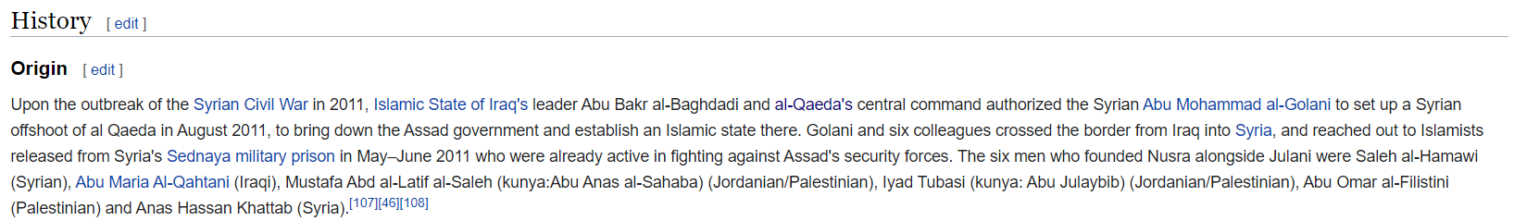
Conclusions
Interesting insights
Why Class 6 always trend to be classified as Class 0 in all Models?

Slide 37
Future Opportunities
Future Opportunities
Import more Attacker-known Terrorist Attack records into Machine Learning Dataset
To classify more attackers and get closer to real-life situation
Fine Tune Feature Selection
Reduce the number of input features with minimum sacrifice of classification performance
Predict potential threatening Attackers

Slide 38
Q&A
Q & A

Slide 39
Thank you!
Li Zheming

